Slide 1


Shuyu Victoria Xiao
JUN 20, 2024

Slide 2

Outline
Executive Summary
Introduction
Methodology
Results
Conclusion

Slide 3
Executive Summary
In this capstone project, we aim to predict whether the SpaceX Falcon 9 first stage will land successfully by utilizing several machine learning classification algorithms. The main steps in this project include:
Data collection, wrangling, and formatting
Exploratory data analysis
Interactive data visualization
Machine learning prediction
Our analysis reveals that certain features of the rocket launches correlate with the launch outcomes, i.e., success or failure. Furthermore, we conclude that the decision tree algorithm may be the most effective for predicting the successful landing of the Falcon 9 first stage.

Slide 4
Introduction
In this capstone project, we will predict whether the Falcon 9 first stage will land successfully. SpaceX advertises its Falcon 9 rocket launches at a cost of $62 million, while other providers charge upwards of $165 million. Much of this cost savings comes from SpaceX's ability to reuse the first stage. Therefore, determining the likelihood of the first stage landing successfully can help estimate the cost of a launch. This information can be valuable for alternative companies looking to compete with SpaceX for rocket launch bids.
Most unsuccessful landings are planned, as SpaceX sometimes performs controlled landings in the ocean. The main question we aim to answer is whether the first stage of the Falcon 9 rocket will land successfully based on a given set of features, including payload mass, orbit type, launch site, and other relevant factors.

Slide 5

Section 1

Slide 6
Methodology
The overall methodology includes the following steps:
Data collection, wrangling, and formatting, utilizing:
SpaceX API
Web scraping techniques
Exploratory data analysis (EDA), using tools such as:
Pandas and NumPy
SQL
Data visualization, employing:
Matplotlib and Seaborn
Folium
Dash
Machine learning prediction, implementing algorithms like:
Logistic regression
Support vector machine (SVM)
Decision tree
K-nearest neighbors (KNN)

Slide 7
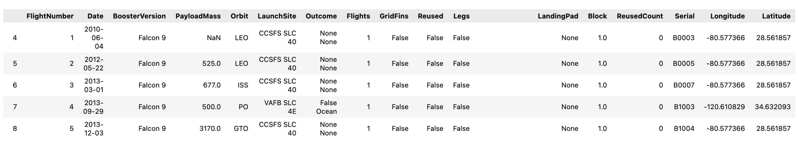
Data Collection – SpaceX API
SpaceX API
The API utilized is https://api.spacexdata.com/v4/rockets/.
This API provides data on various types of rocket launches conducted by SpaceX. The data is filtered to include only Falcon 9 launches.
Missing values in the data are replaced with the mean of the respective columns.
The final dataset consists of 90 rows (instances) and 17 columns (features). The image below displays the first few rows of the data:

Slide 8
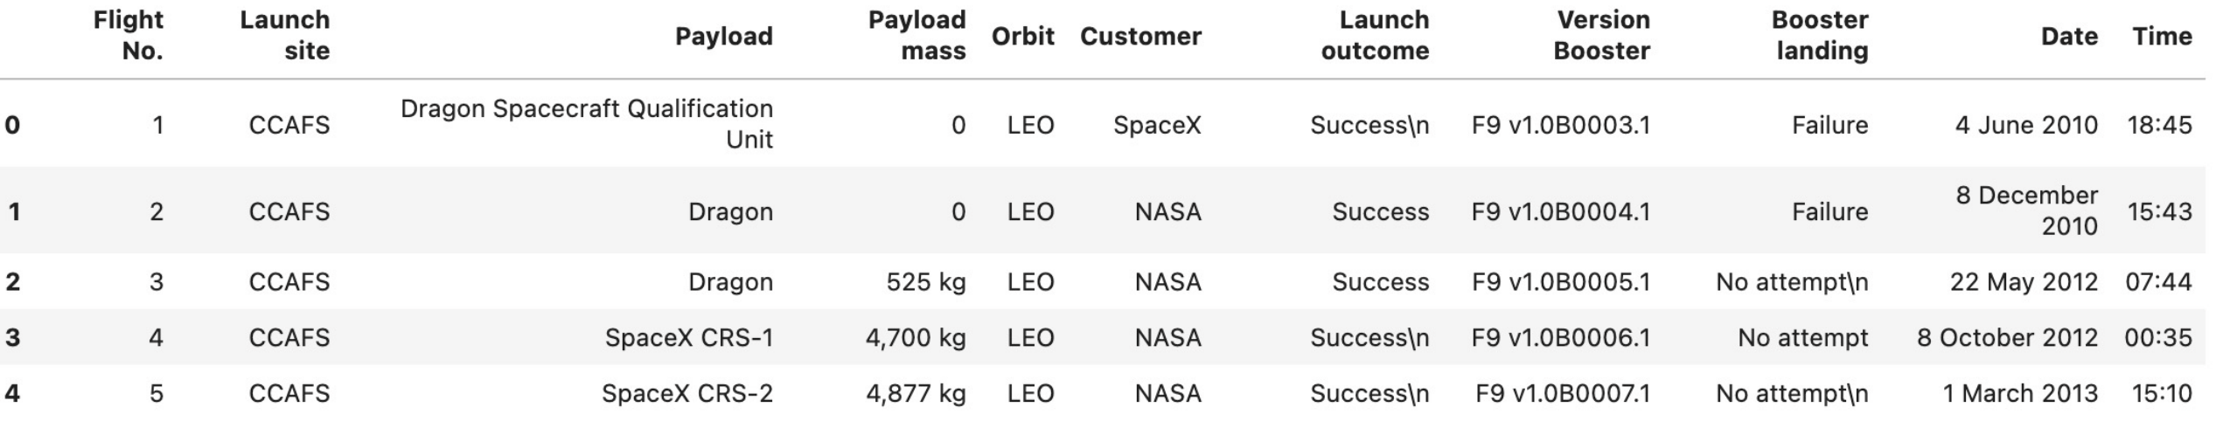
Data Collection - Scraping
Web ScrapingThe data is scraped from this Wikipedia page.
This webpage contains data exclusively about Falcon 9 launches.
The final dataset consists of 121 rows (instances) and 11 columns (features). The image below displays the first few rows of the data:

Slide 9
Data Wrangling
Data Processing
The data is processed to ensure there are no missing entries, and categorical features are encoded using one-hot encoding.
An additional column, 'Class', is added to the data frame. The 'Class' column contains 0 for failed launches and 1 for successful ones.
The final dataset consists of 90 rows (instances) and 83 columns (features).

Slide 10
EDA with Data Visualization
Pandas and NumPy
Functions from the Pandas and NumPy libraries are utilized to extract basic information from the collected data, including:
The number of launches at each launch site
The frequency of each orbit type
The number and frequency of each mission outcome
SQL
The data is queried using SQL to answer various questions, such as:
The names of the unique launch sites in the space missions
The total payload mass carried by boosters launched by NASA (CRS)
The average payload mass carried by booster version F9 v1.1

Slide 11
EDA with Data Visualization
Matplotlib and Seaborn
Functions from the Matplotlib and Seaborn libraries are used to visualize the data through scatterplots, bar charts, and line charts.
These plots and charts help to understand the relationships between various features, such as:
The relationship between flight number and launch site
The relationship between payload mass and launch site
The relationship between success rate and orbit type
Folium
Functions from the Folium library are used to visualize the data through interactive maps.
The Folium library is used to:
Mark all launch sites on a map
Mark the successful and failed launches for each site on the map
Indicate the distances between a launch site and nearby proximities, such as the nearest city, railway, or highway

Slide 12
EDA with Data Visualization
Dash functions are employed to build an interactive site that allows users to adjust inputs via a dropdown menu and a range slider.
The interactive site features a pie chart and a scatterplot to display:
The number of successful launches at each launch site
The relationship between payload mass and mission outcome (success or failure) for each launch site

Slide 13
Machine Learning Prediction
Scikit-learn functions are employed to build our machine-learning models.
The machine learning prediction phase includes the following steps:
Standardizing the data
Dividing the data into training and test sets
Developing machine learning models, such as:
Logistic regression
Support vector machine (SVM)
Decision tree
K-nearest neighbors (KNN)
Training the models on the training set
Identifying the best hyperparameter combination for each model
Assessing the models using accuracy scores and confusion matrices

Slide 14
Results
The results are divided into five sections:
SQL (Exploratory Data Analysis with SQL)
Matplotlib and Seaborn (Exploratory Data Analysis with Visualization)
Folium
Dash
Predictive Analysis
In all subsequent graphs, class 0 denotes a failed launch outcome, while class 1 denotes a successful launch outcome.

Slide 15
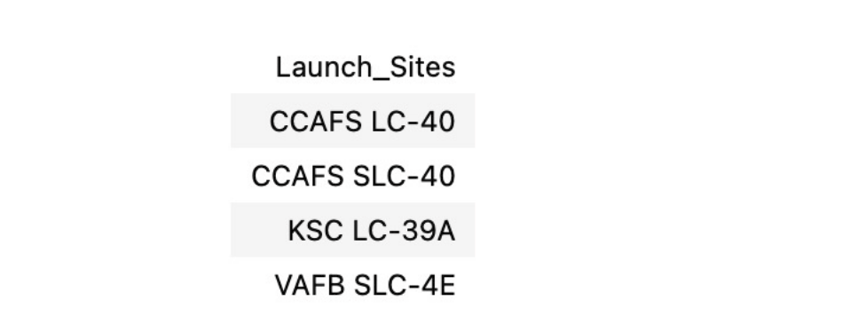
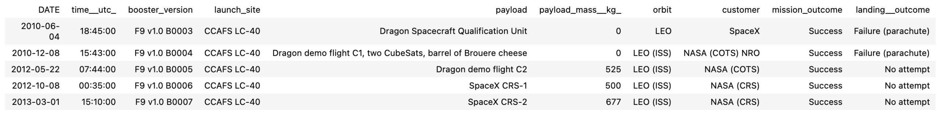
EDA with SQL
The names of the unique launch sites in the space mission
5 records where launch sites begin with ‘CCA’

Slide 16



EDA with SQL
The total payload mass carried by boosters launched by NASA (CRS)
The average payload mass carried by booster version F9 v1.1
The date when the first successful landing outcome in ground pad was achieved

Slide 17
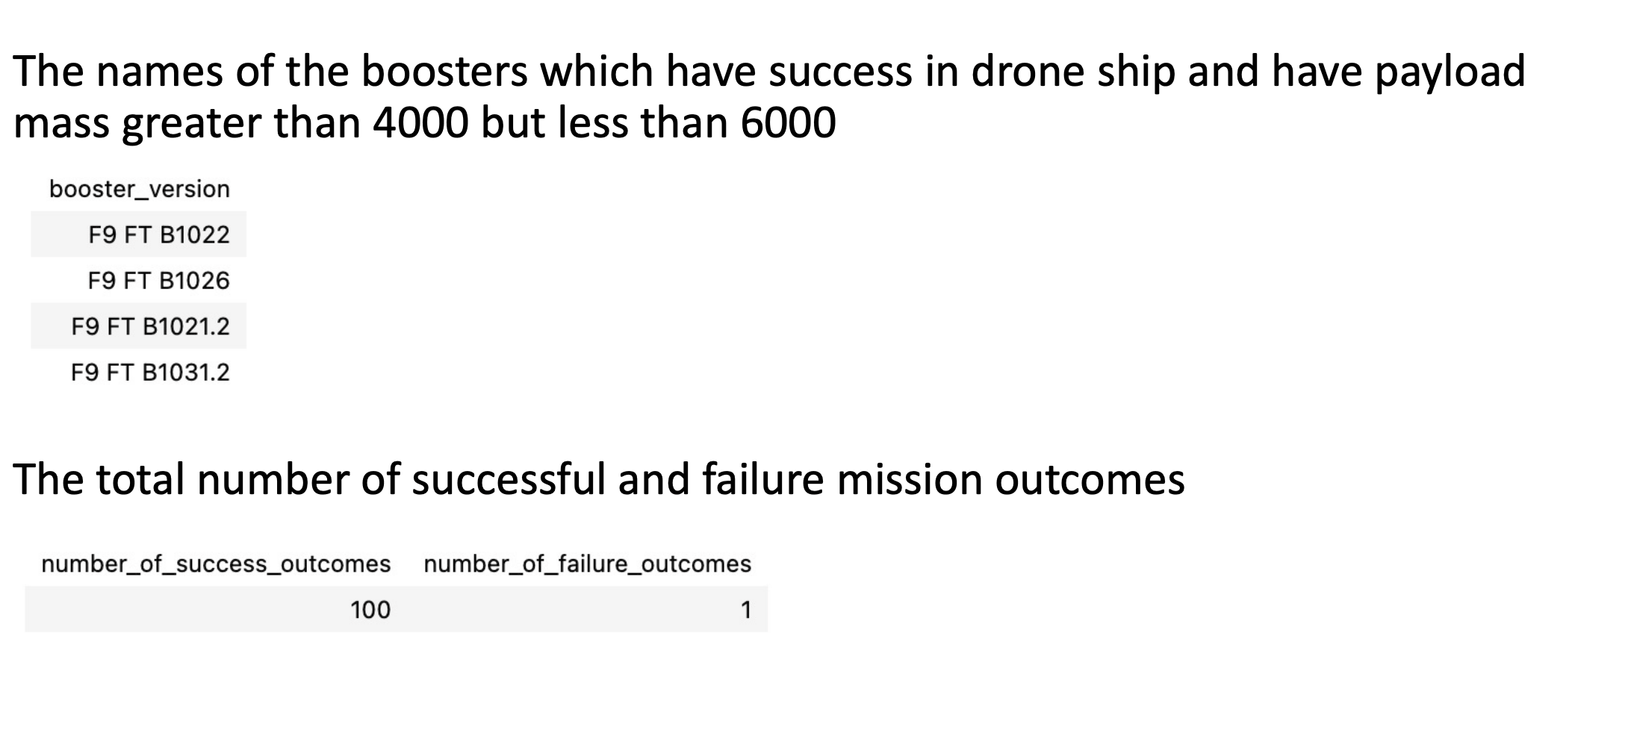
EDA with SQL

Slide 18
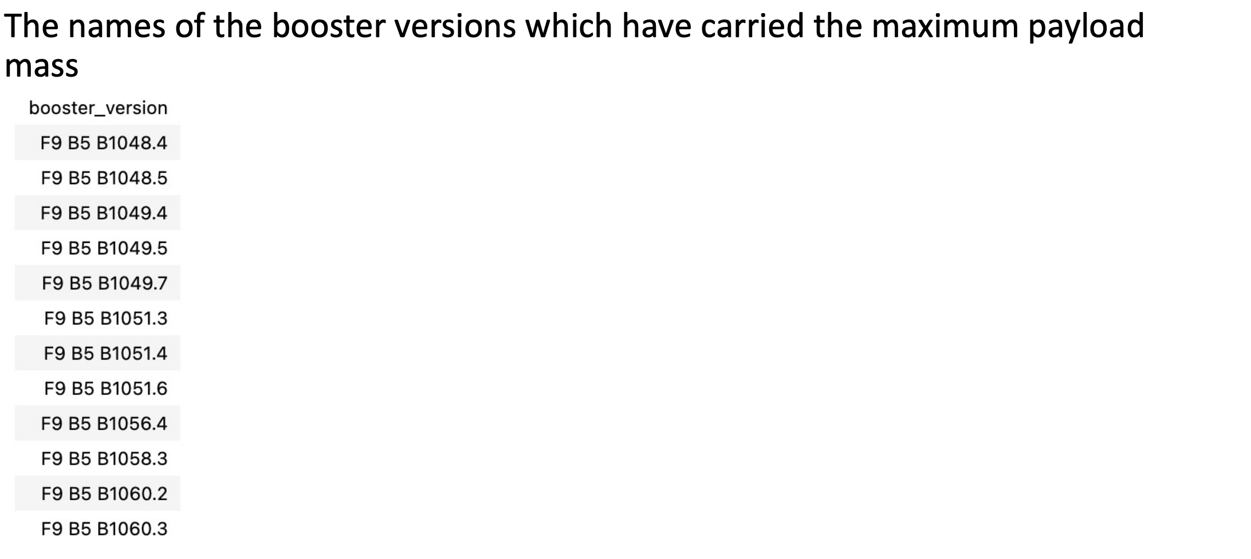
EDA with SQL

Slide 19
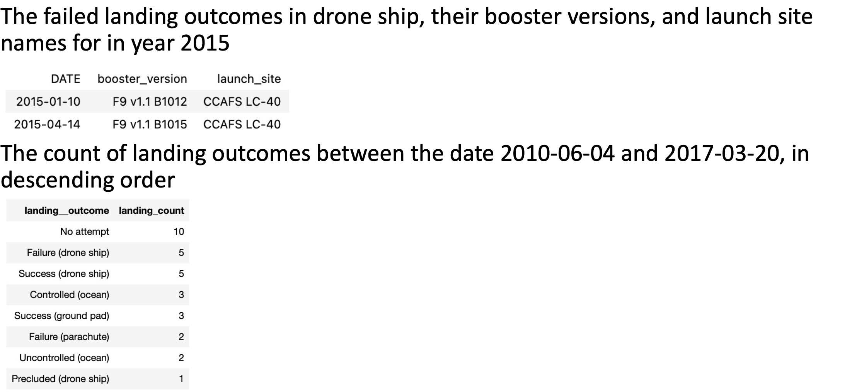
EDA with SQL

Slide 20
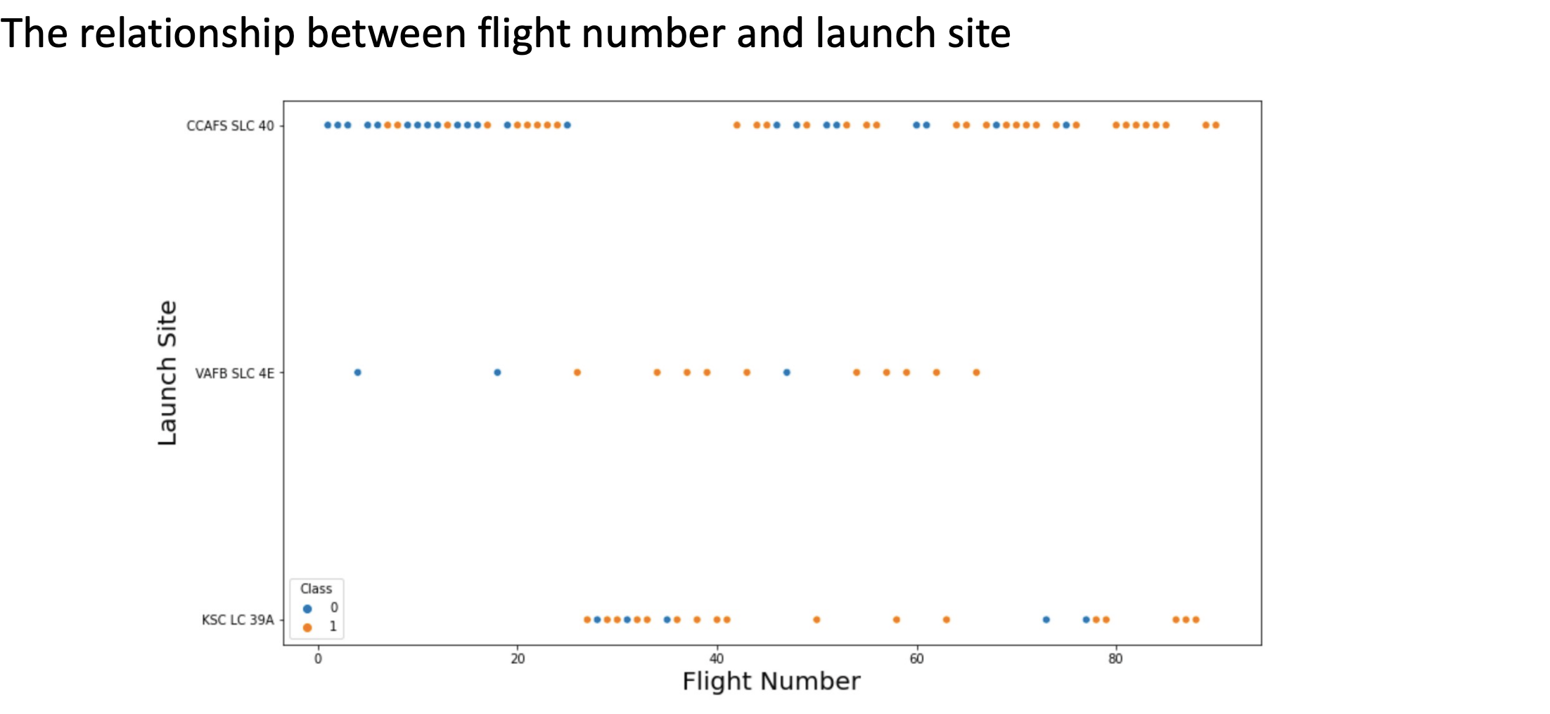
Maplotlib and Seaborn(EDA with Visualization)

Slide 21
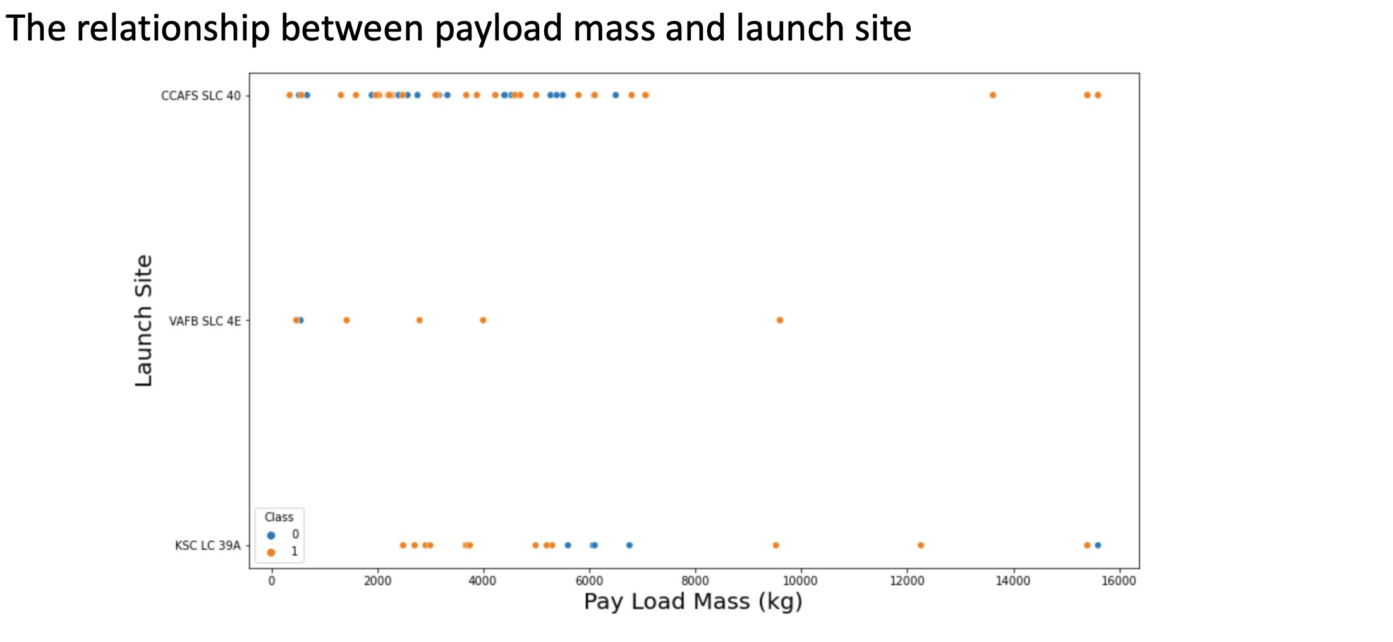
Maplotlib and Seaborn(EDA with Visualization)

Slide 22
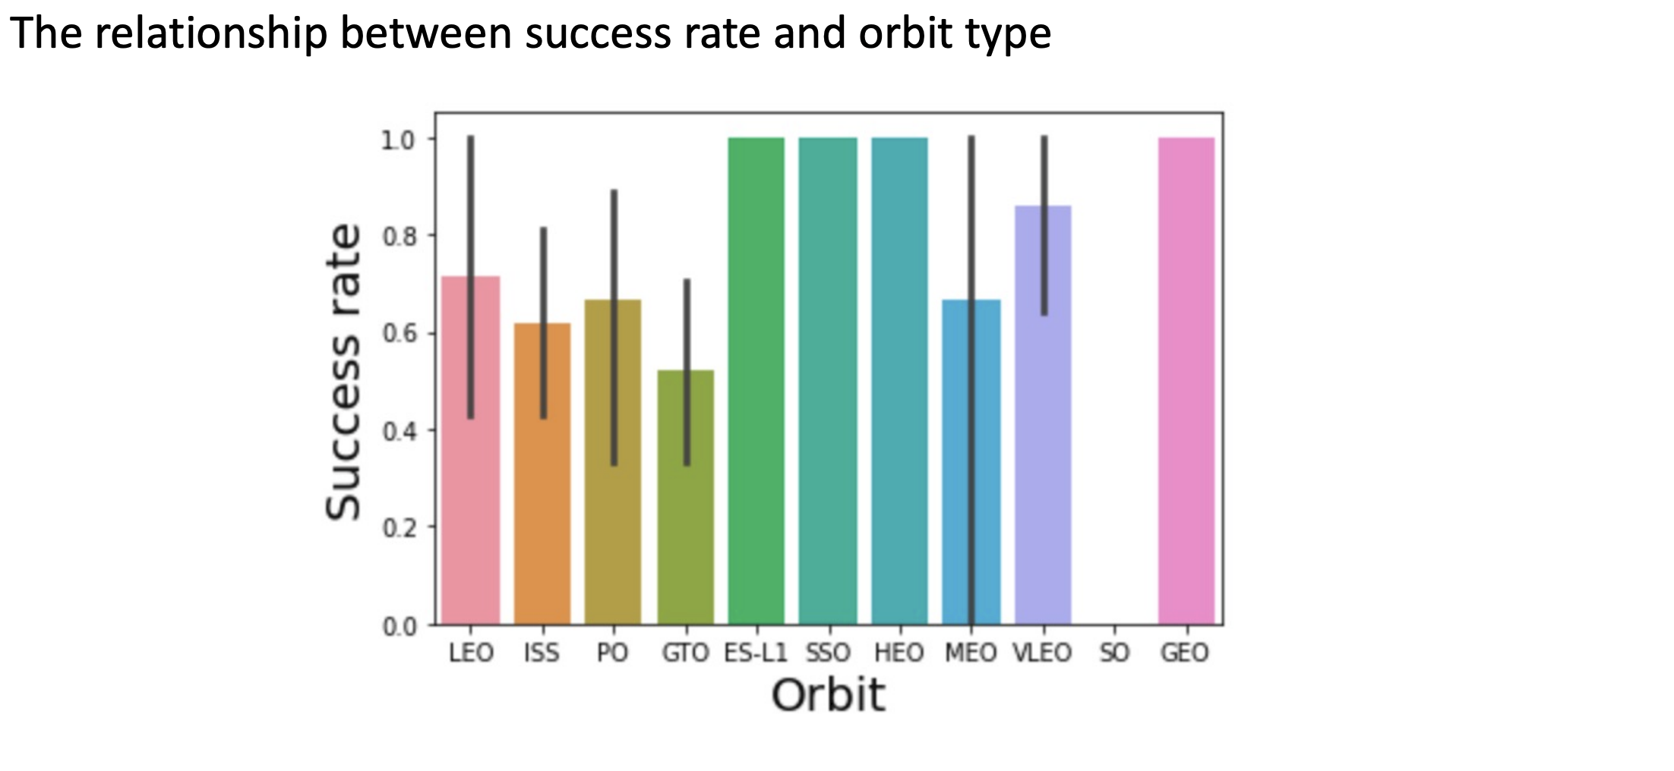
Maplotlib and Seaborn(EDA with Visualization)

Slide 23
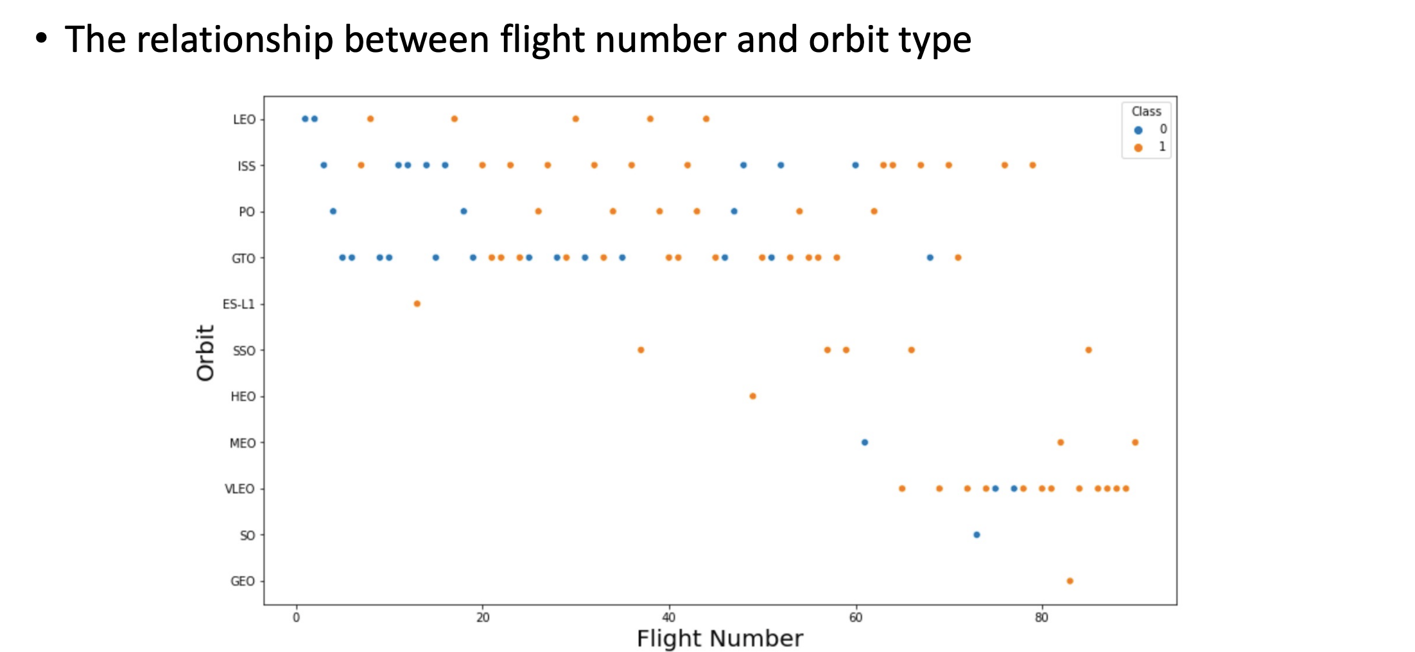
Maplotlib and Seaborn(EDA with Visualization)

Slide 24
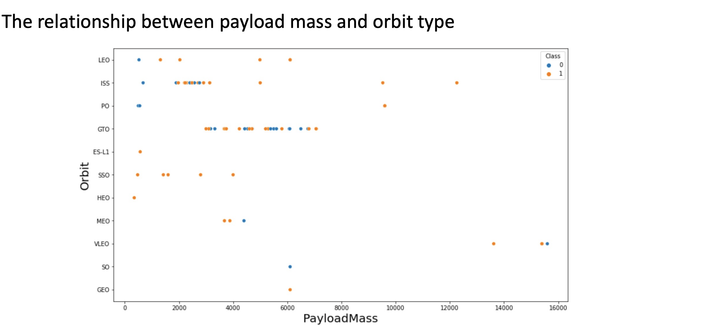
Maplotlib and Seaborn(EDA with Visualization)

Slide 25
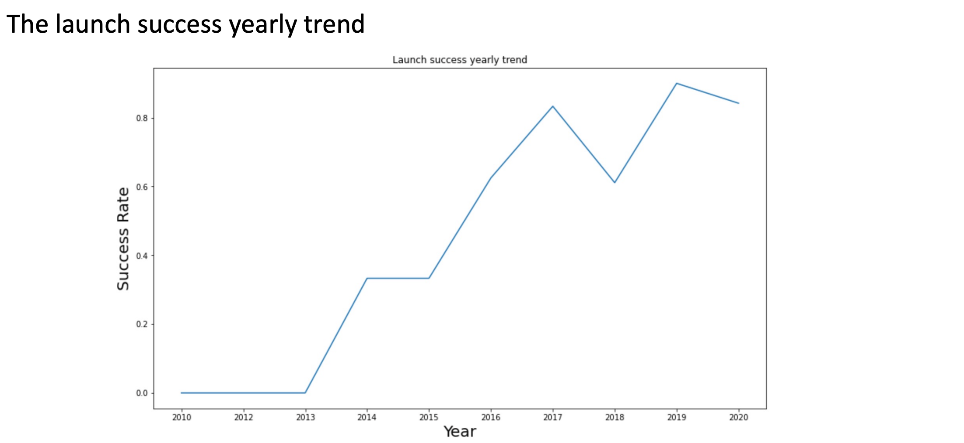
Maplotlib and Seaborn(EDA with Visualization)

Slide 26
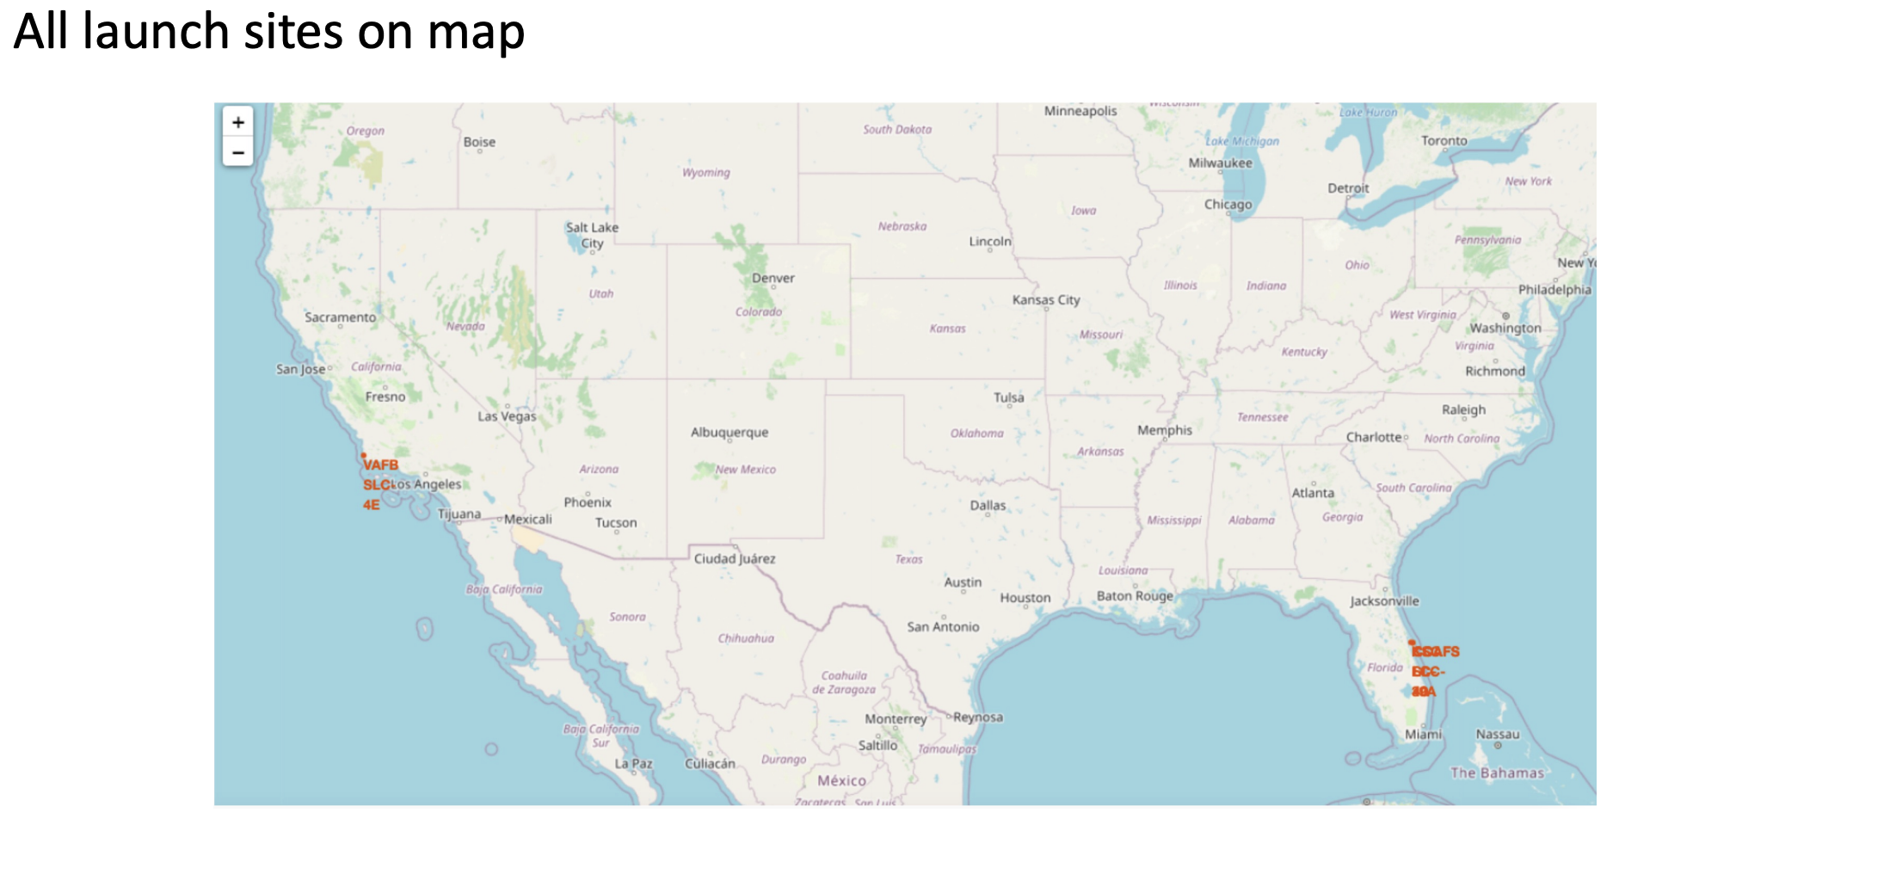
Build an Interactive Map with Folium

Slide 27
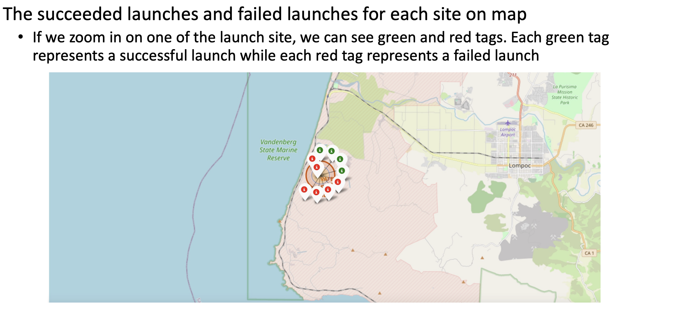
Build an Interactive Map with Folium

Slide 28
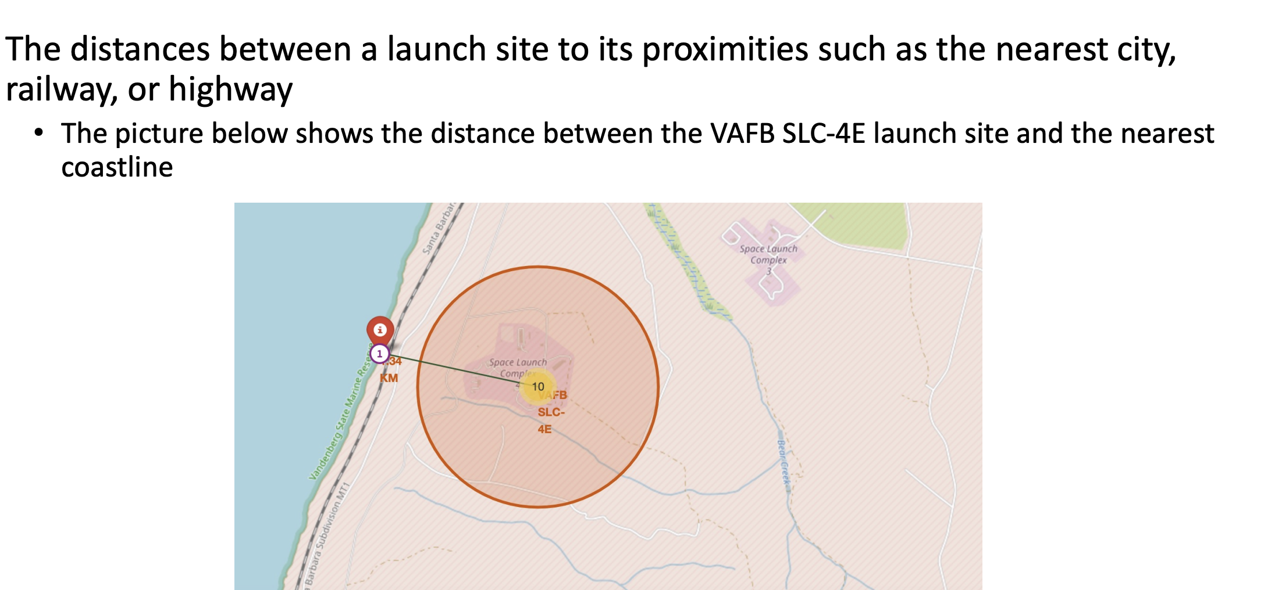
Build an Interactive Map with Folium

Slide 29
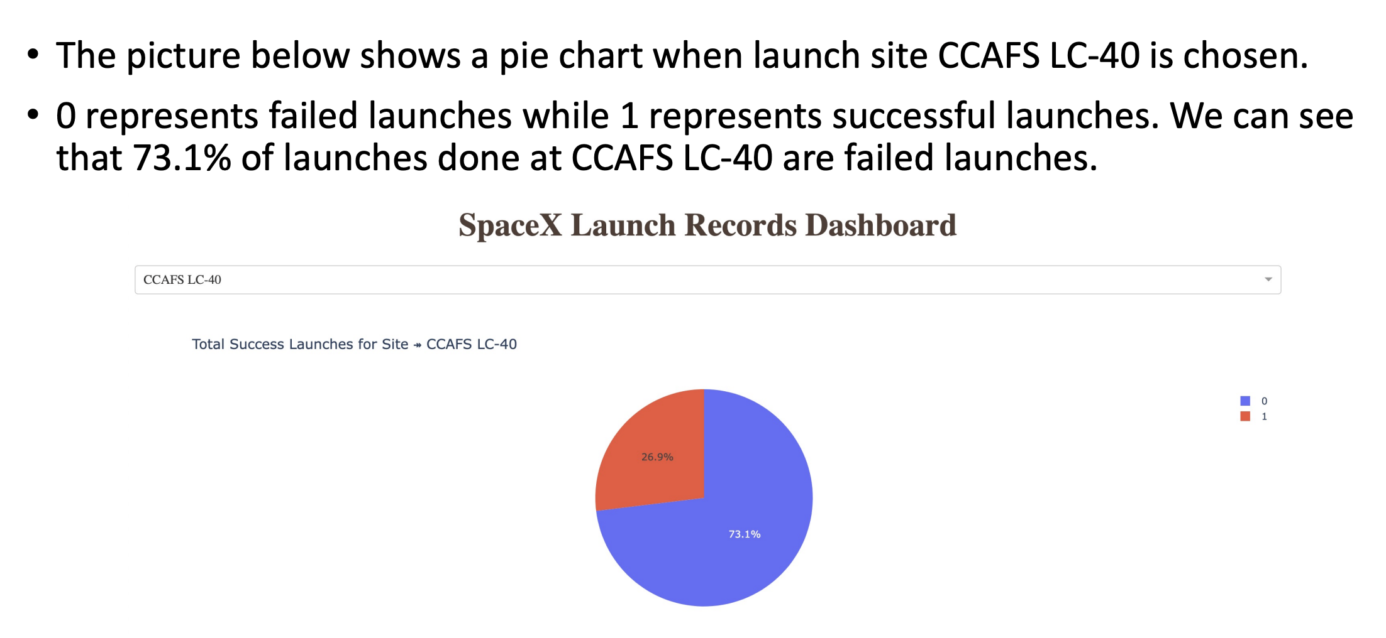
Build a Dashboard with Plotly Dash

Slide 30
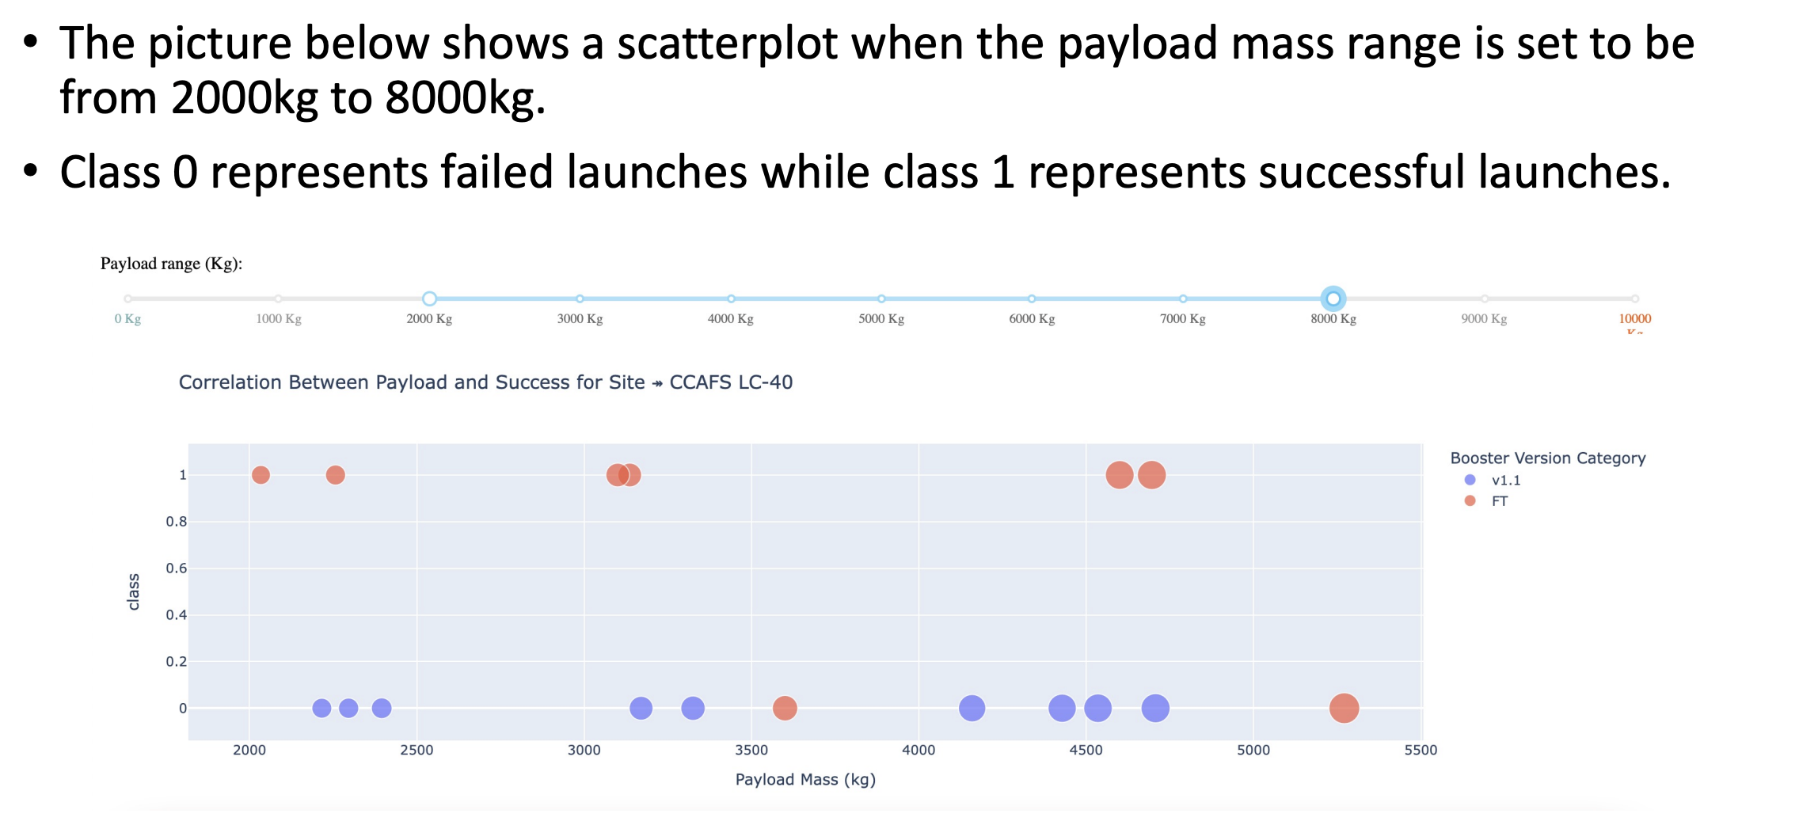
Build a Dashboard with Plotly Dash

Slide 31
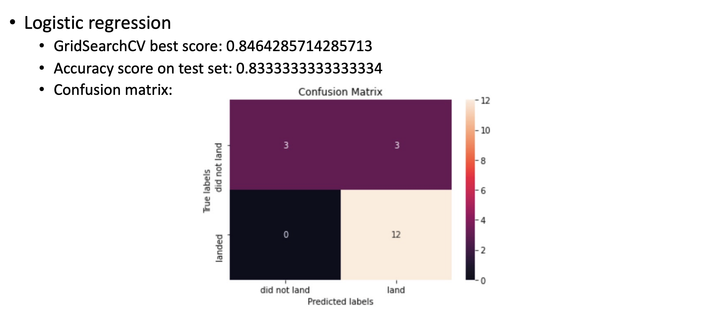
Predictive Analysis (Classification)

Slide 32
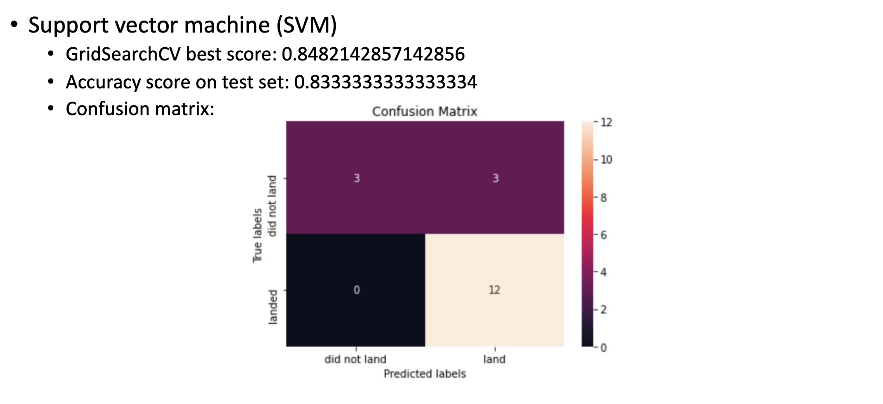
Results-Predictive Analysis

Slide 33

Results-Predictive Analysis

Slide 34
Results-Predictive Analysis
When comparing the results of all 4 models side by side, it is evident that they all have the same accuracy score and confusion matrix when evaluated on the test set. Consequently, the GridSearchCV best scores are used to rank the models. Based on these scores, the models are ranked as follows, from best to worst: Decision tree (GridSearchCV best score: 0.8893)
K nearest neighbors (KNN) (GridSearchCV best score: 0.8482)
Support vector machine (SVM) (GridSearchCV best score: 0.8482)
Logistic regression (GridSearchCV best score: 0.8464)

Slide 35

Section 2
DISCUSSION

Slide 36
Correlation Between Features and Mission Outcomes
The data visualization section reveals that certain features may correlate with mission outcomes in various ways. For instance, heavy payloads tend to have higher successful landing rates for orbit types such as Polar, LEO, and ISS. However, this distinction is less clear for GTO, where both successful and unsuccessful landing rates are present.
Thus, each feature may influence the final mission outcome. While the exact impact of each feature is challenging to determine, machine learning algorithms can be employed to analyze past data patterns and predict mission success based on the given features.

Slide 37
Conclusion
This project aims to predict whether the first stage of a Falcon 9 launch will land successfully, helping to determine the overall launch cost.
Each feature of a Falcon 9 launch, such as payload mass and orbit type, can influence the mission outcome.
Various machine learning algorithms are utilized to analyze historical Falcon 9 launch data and develop predictive models for launch outcomes.
Among the four machine learning algorithms tested, the decision tree algorithm produced the most accurate predictive model.

Slide 38


